Slide 1
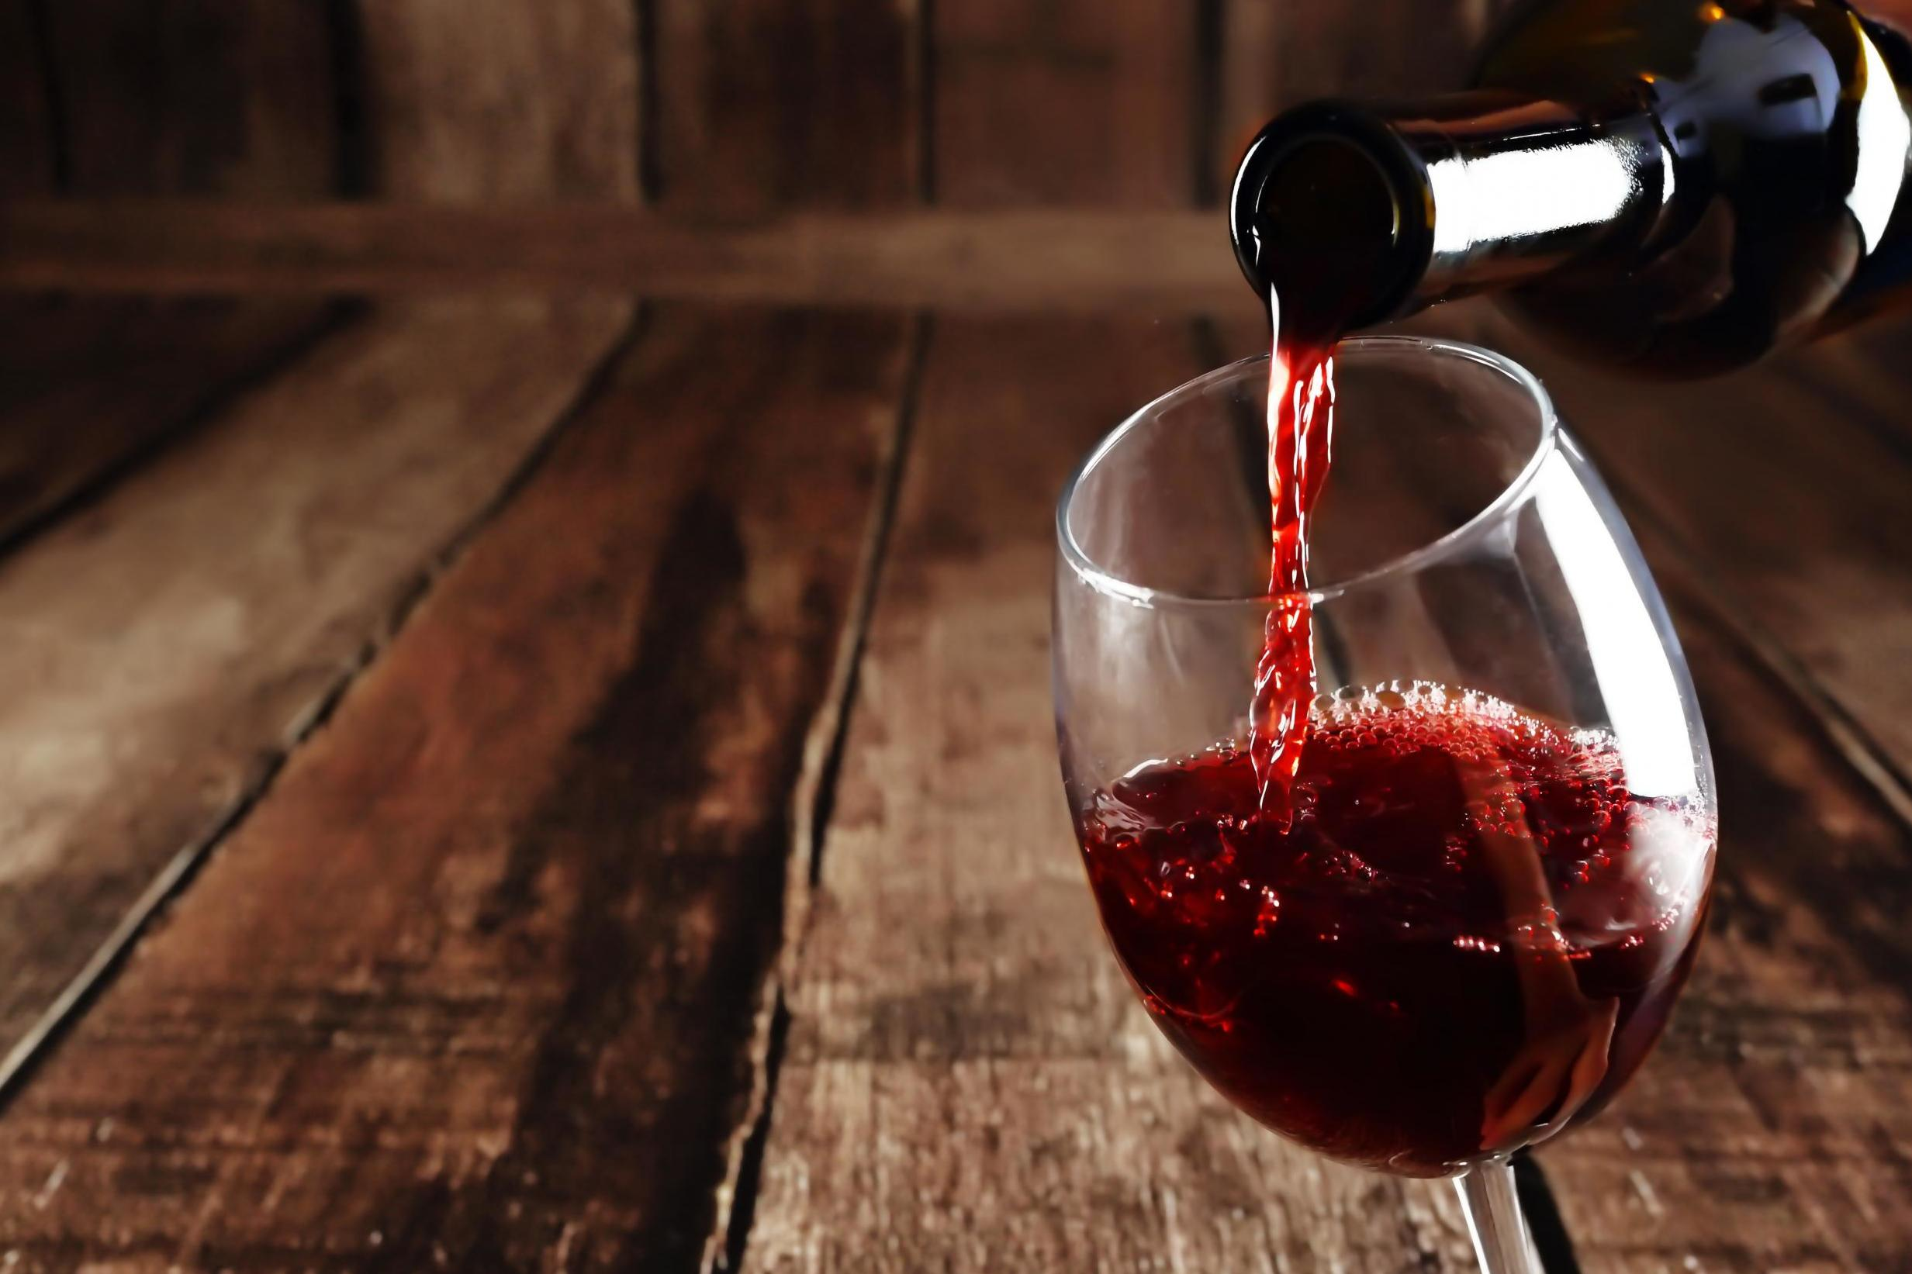
EDA of Wine Data Set And Prediction of Wine Quality
- RUTWIK JAYANT DEOKAR

Slide 2
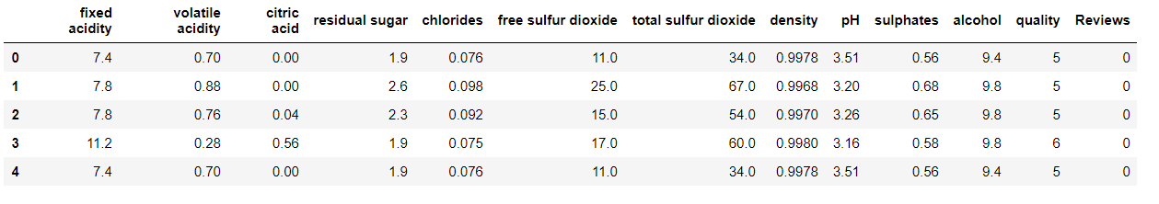
Variables:
Dependent Variable : Quality
Independent Variables:
Fixed Acidity
Volatile Acidity
Citric Acid
Residual Sugar
Chlorides
Free Sulphur Dioxide
Total Sulphur Dioxide
Density
pH
Sulphates
Alcohol

Slide 3
Tools Used:
Python and its libraries:
Numpy
Pandas
Matplotlib
Seaborn
SciKit Learn for Classification Algorithms

Slide 4
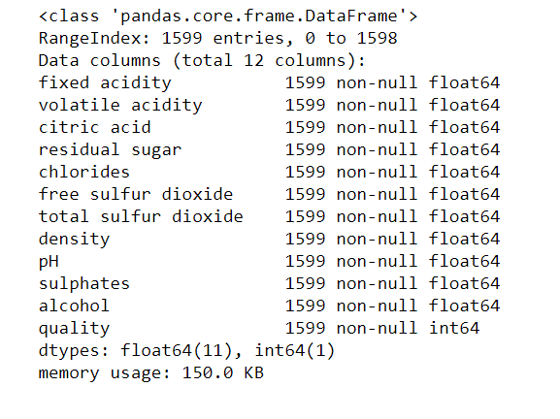
Checking for missing Data

Slide 5
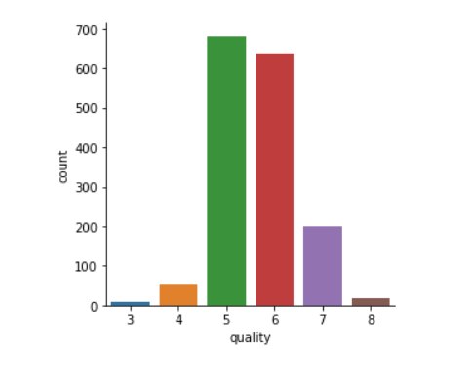
Wine Quality Count
Most of the wines in this data set seem to have a quality of 5 or 6.

Slide 6
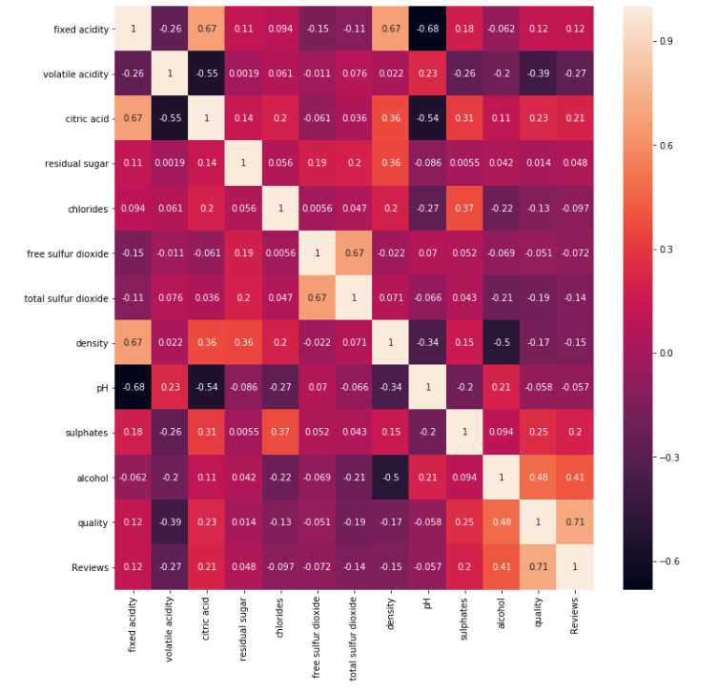
Correlation Heat-map Matrix:
Variables with Maximum Correlation:
Alcohol
Sulphates
Citric Acid

Slide 7
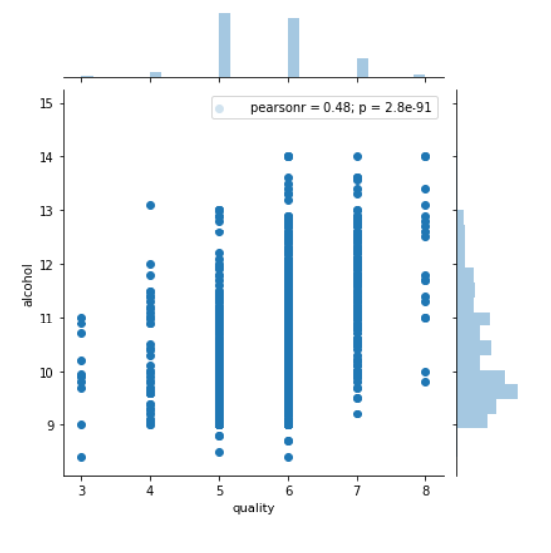
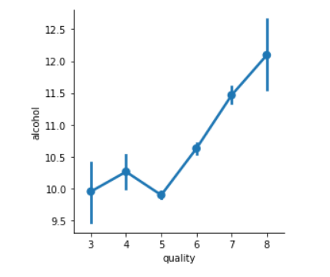
Joint and factor Plots for Alcohol V/S Quality

Slide 8
Algorithms used for Classification
Random Forest Classifier
Support Vector Classifier

Slide 9
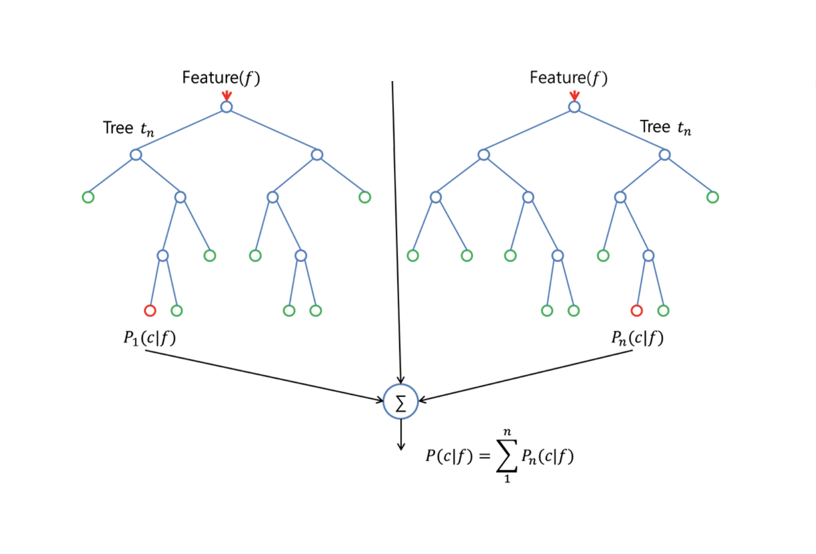
Random Forest Algorithm

Slide 10
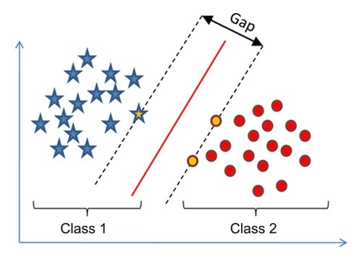
Support vector classifier

Slide 11
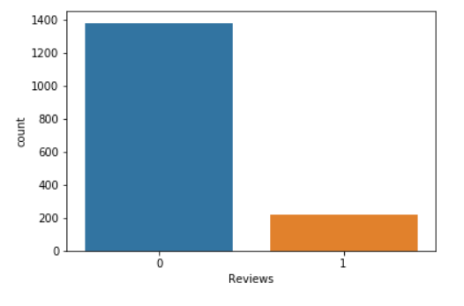
Converting to Binary Classification
Added Reviews Variable that categorizes all the wines with qualities lower than 7 as “Bad” or “0” and all the wines with qualities greater than 6 as “Good” or “1”

Slide 12
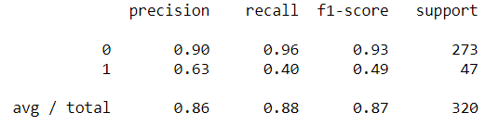
Random Forest Accuracy – 86-87%

Slide 13
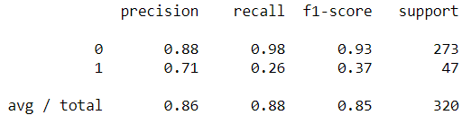
Support vector Accuracy – 85-86%

Slide 14
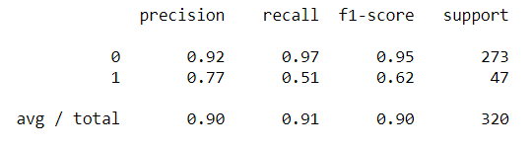
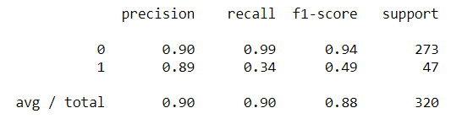
Optimization
Used Grid Search Cross Validation to find the best Hyper Parameters and used those parameters to train the model again.
Optimized Random Forest Accuracy
Optimized Support Vector Classifier Accuracy

Slide 15
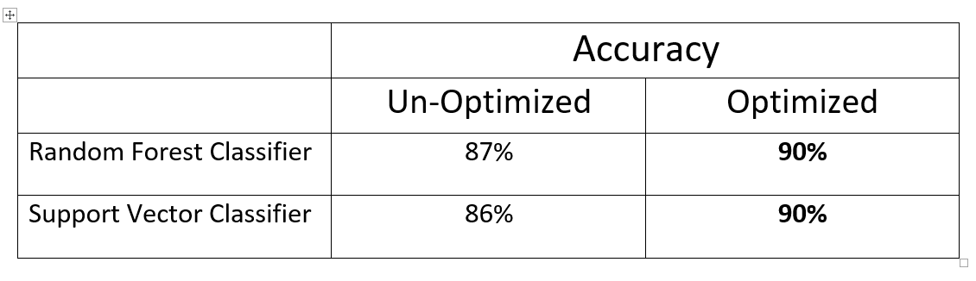
Accuracies After Optimization

Slide 16
THANK YOU !

